Slide 1

Find Your College
GR5243 Project 2 by Group 4

Slide 2
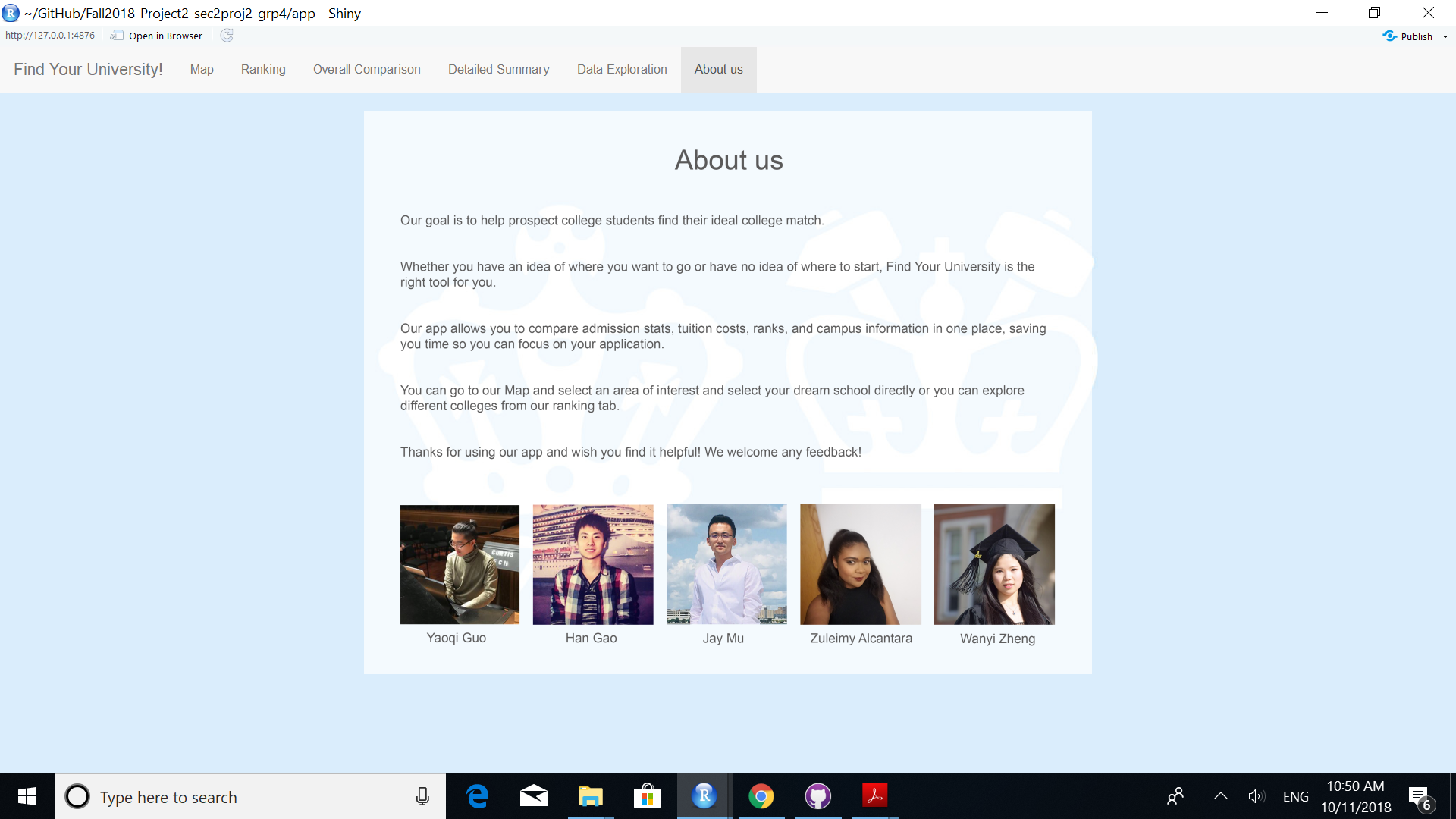
About Our App
Notes:
The brief introduction of our App

Slide 3
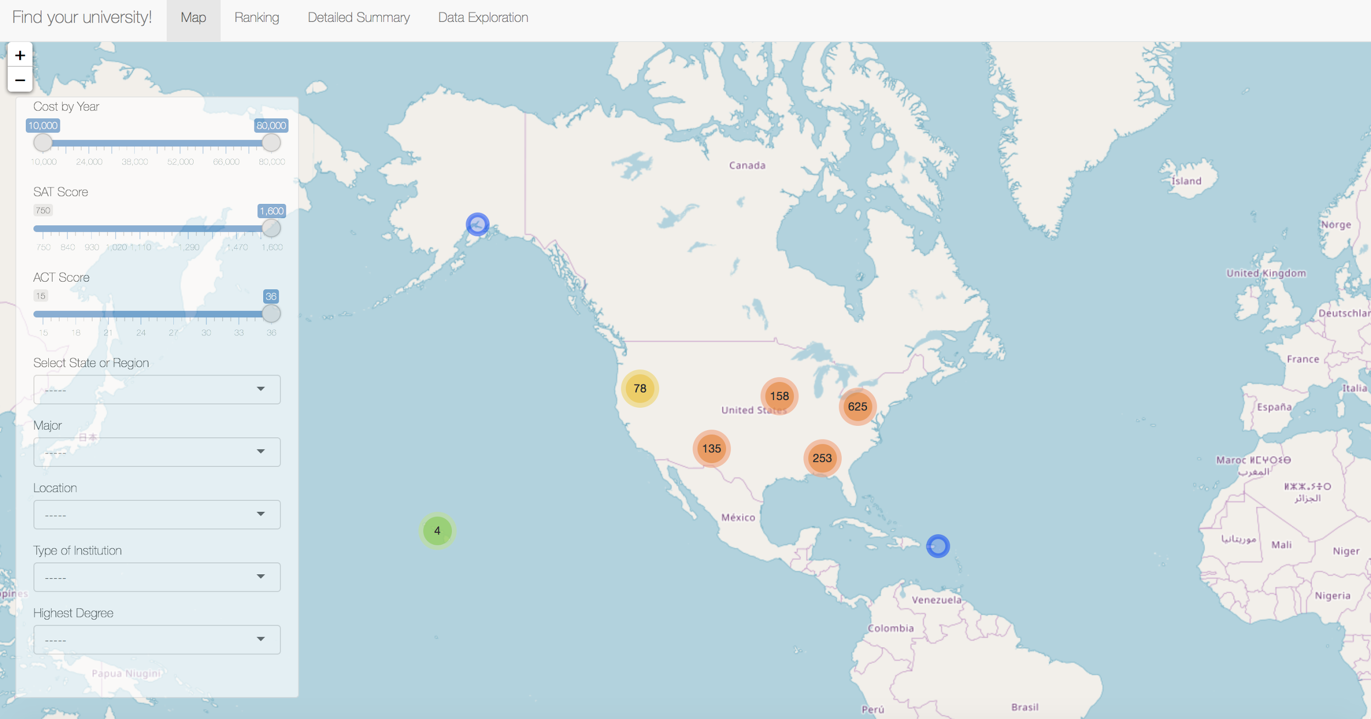
Notes:
The introduction of our “Map” searching engine, functions of each searching bar

Slide 4
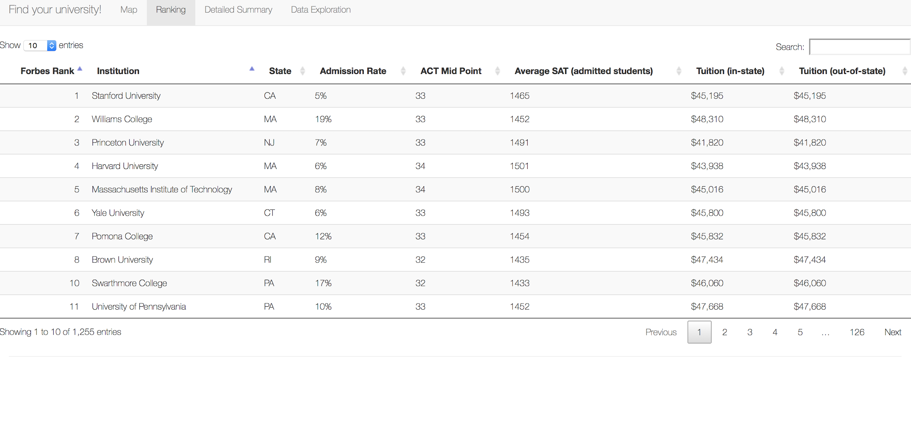
Notes:
Intro of the ranking page, what kind of stats of the are compare in this page

Slide 5
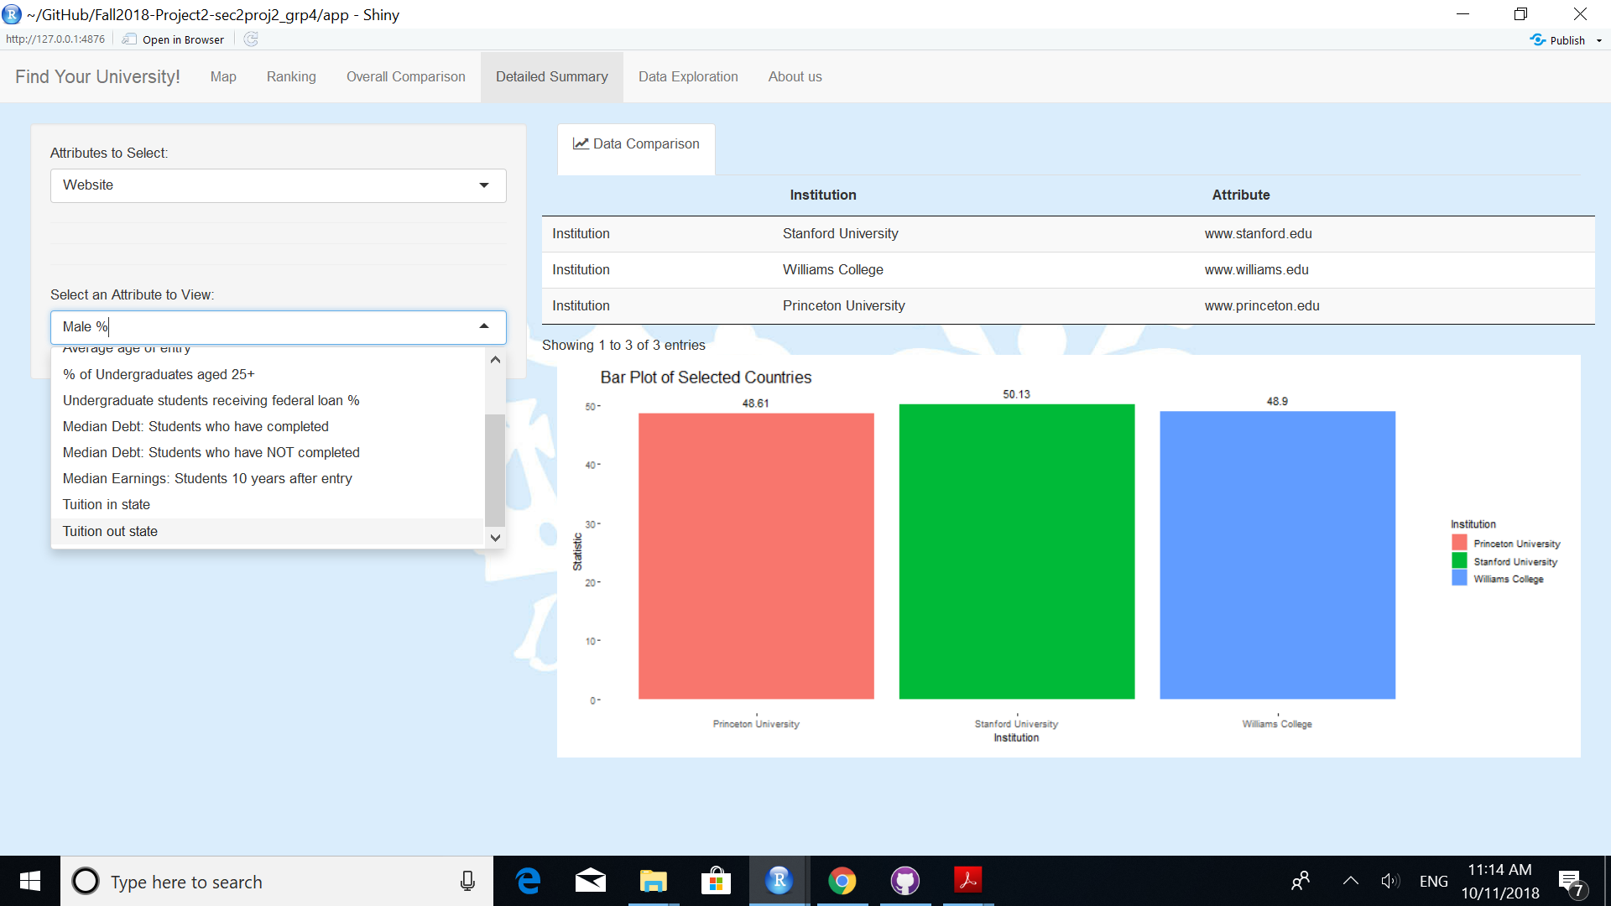
Notes:
Introduction to the detailed summary

Slide 6
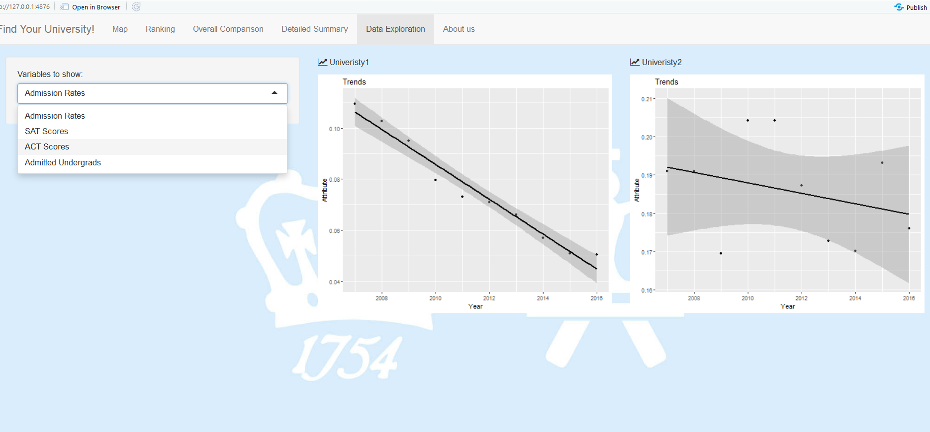
Notes:
Functions of the “trend” of statistics for 2 universities

Slide 7
URL to our Website
https://han-gao.shinyapps.io/FindYourUniversity/

